Slide 1
Job evaluation

Slide 2
What does it means?
Job evaluation is a systematic way of determining the vale / worth of a job in relation to other jobs in an organisation.

Slide 3
Internal equity and external equity
Internal equity is how one employee's pay package compares to others inside the same organization.
External equity compares a pay package to others outside the organization.
In this case the word “equity” refers to “fairness” or “equivalence” and has nothing to do with share-based (equity-based) compensation.

Slide 4
Key features of job evaluation
Tries evaluate the job, not people
Basis of job evaluation is job analysis
Job evaluation always done by group, not individual

Slide 5
Job analysis Vs. Job evaluation
Job analysis: A systematic way of gathering information about job.
Job evaluation begins with job analysis and ends at the point of determination of worth of a job.

Slide 6
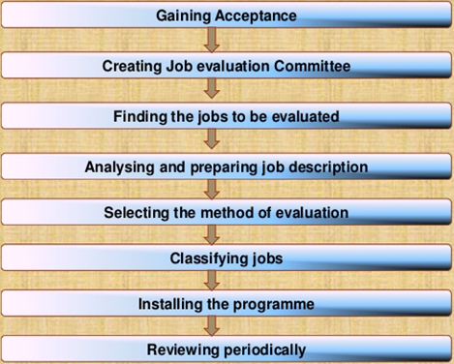
Process of Job Evaluation

Slide 7
Job evaluation method
Ranking
Classification
Factor comparison
Point method

Slide 8
Ranking method
Jobs are arranged from highest to lowest in order of their value or merit.
Also arranged according to the relative difficulty in performing them.
Job at the top is having highest value vice versa.
Rank | Monthly salaries
Accountant | 10000
2. Accounts clerk | 7000
3.Purchase assistant | 5000
4.Machine operator | 4500
5. Typist | 3500
6.Office boy | 3000

Slide 9
Classification method
Jobs are determined by established job classes.
Grouping of several jobs in to one job grades.
Example:
Class I: executives (office manager, deputy office manager, office superintendent, departmental supervisor)
Class II: skilled workers (purchasing assistant, cashier)
Class III: semi-skilled worker (steno typist, machine-operators, switch board operator)
Class IV: unskilled worker (file clerks, office boy)

Slide 10
Factor comparisons method
In the ranking method we have rank the job on the basis of their merit in the organisation.
But in factor comparison method, instead of ranking complete jobs, each job is ranked according to the factors.
Example of factors in a job = mental effort, physical effort, skill needed, responsibility, supervisory responsibility, working condition, problem solving.

Slide 11
Steps involved in factor comparison method
Select the key jobs
Find the factors in terms of which the jobs are evaluated
Rank the selected jobs under each factor
Assign money value to each factor and determine the wage rate.

Slide 12
Example
Factors Key job | Daily wage rate | Physical effort | Factors mental effort | Skill | Responsibility | Working condition
Electrician Fitter Welder Cleaner Labourer | 60 50 40 30 25 | 11(3) 14(1) 12(2) 9 (4) 8(5) | 14(1) 10(2) 7(3) 6(4) 4(5) | 15(1) 9(2) 8(3) 4(5) 6(4) | 12(1) 8(2) 7(3) 6(4) 3(5) | 8(2) 9(1) 6(3) 5(4) 4(5)

Slide 13
Point method
This method now-a-days used .
Here the factors of the job prioritise according to its importance.
Then points are summed up to determine the wage rate for the job.
The only difference between factors comparison and point method is , in first one the factors are belong ranked and in the second one the factors are being allocated points.

Slide 14
Steps
Select the key job
Find out the factors associate to job. find the maximum number of points assign to each factor. ( minimum1 and maximum 6). Relative weight has to be decided.
once the worth of a job in terms of total points is expressed, the points are converted into money value.
Example- Area Sales Manager – decide his salary.
Sl. no | Compensable factors | Definition | Relative weight | Levels within factors | Total points
1 | Education | Factor measure the minimum level of formal education | 15 | 6 | 90
2 | Work experience | Minimum amount of job-related experience | 20 | 6 | 120
3 | Leadership | Measures the degree of responsibility for other employees and direct control | 20 | 6 | 120
4 | Independent judgement | It measures the extent of independent authority for making decision | 15 | 6 | 90
5 | Computer skill | It measure the scope and perfection in computer skills required to perform the job | 10 | 5 | 50
Maximum total points of all factors depending on their importance to job = 560

Slide 15
More elaborative way
Sl.no | Compensable factors | L1 | L2 | L3 | L4 | L5 | L6
1 | Education | 15 | 30 | 45 | 60 | 75 | 90
2 | Work experience | 20 | 40 | 60 | 80 | 100 | 120
3 | Leadership | 20 | 40 | 60 | 80 | 100 | 120
4 | Independent judgement | 15 | 30 | 45 | 60 | 75 | 90
5 | Computer skill | 10 | 20 | 30 | 40 | 50 | 60
 | Total | 80
Multiplication of point with relative (minimum weight).

Slide 16
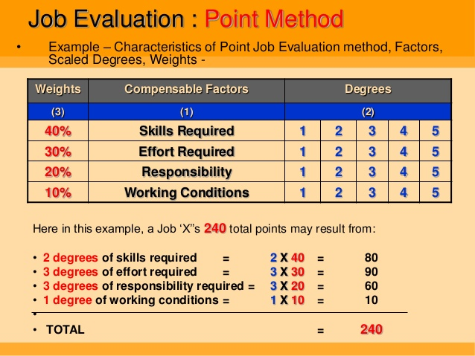

Slide 17
Finally conversion of job grade points to money value
Point range | Daily wage rate | Job grade Sales Department
400-500 | 2000-3000 | 3. Manager I scale (SM)
500-600 | 3001-4000 | 4. Manager II scale (ASM)
700-800 | 4001-5000 | 5. Manager III scale (RSM)

